Slide 1
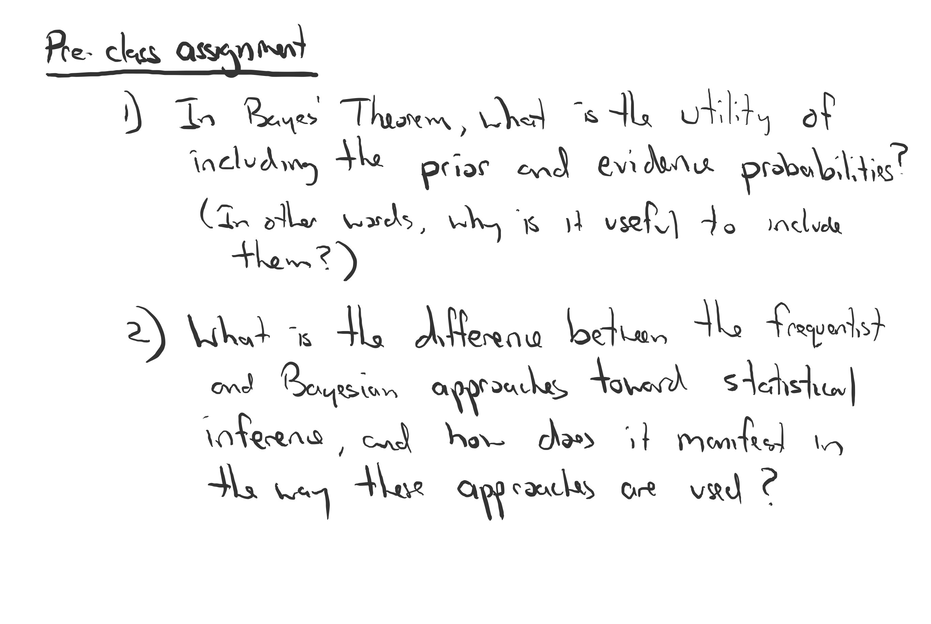

Slide 2
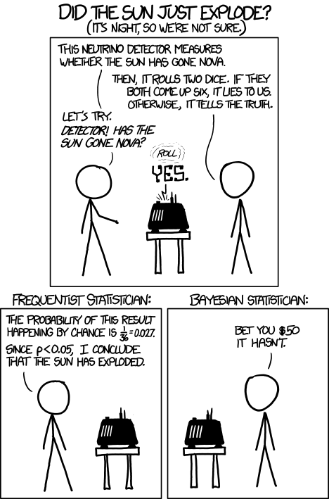
https://xkcd.com/1132/

Slide 3


Slide 4


Slide 5
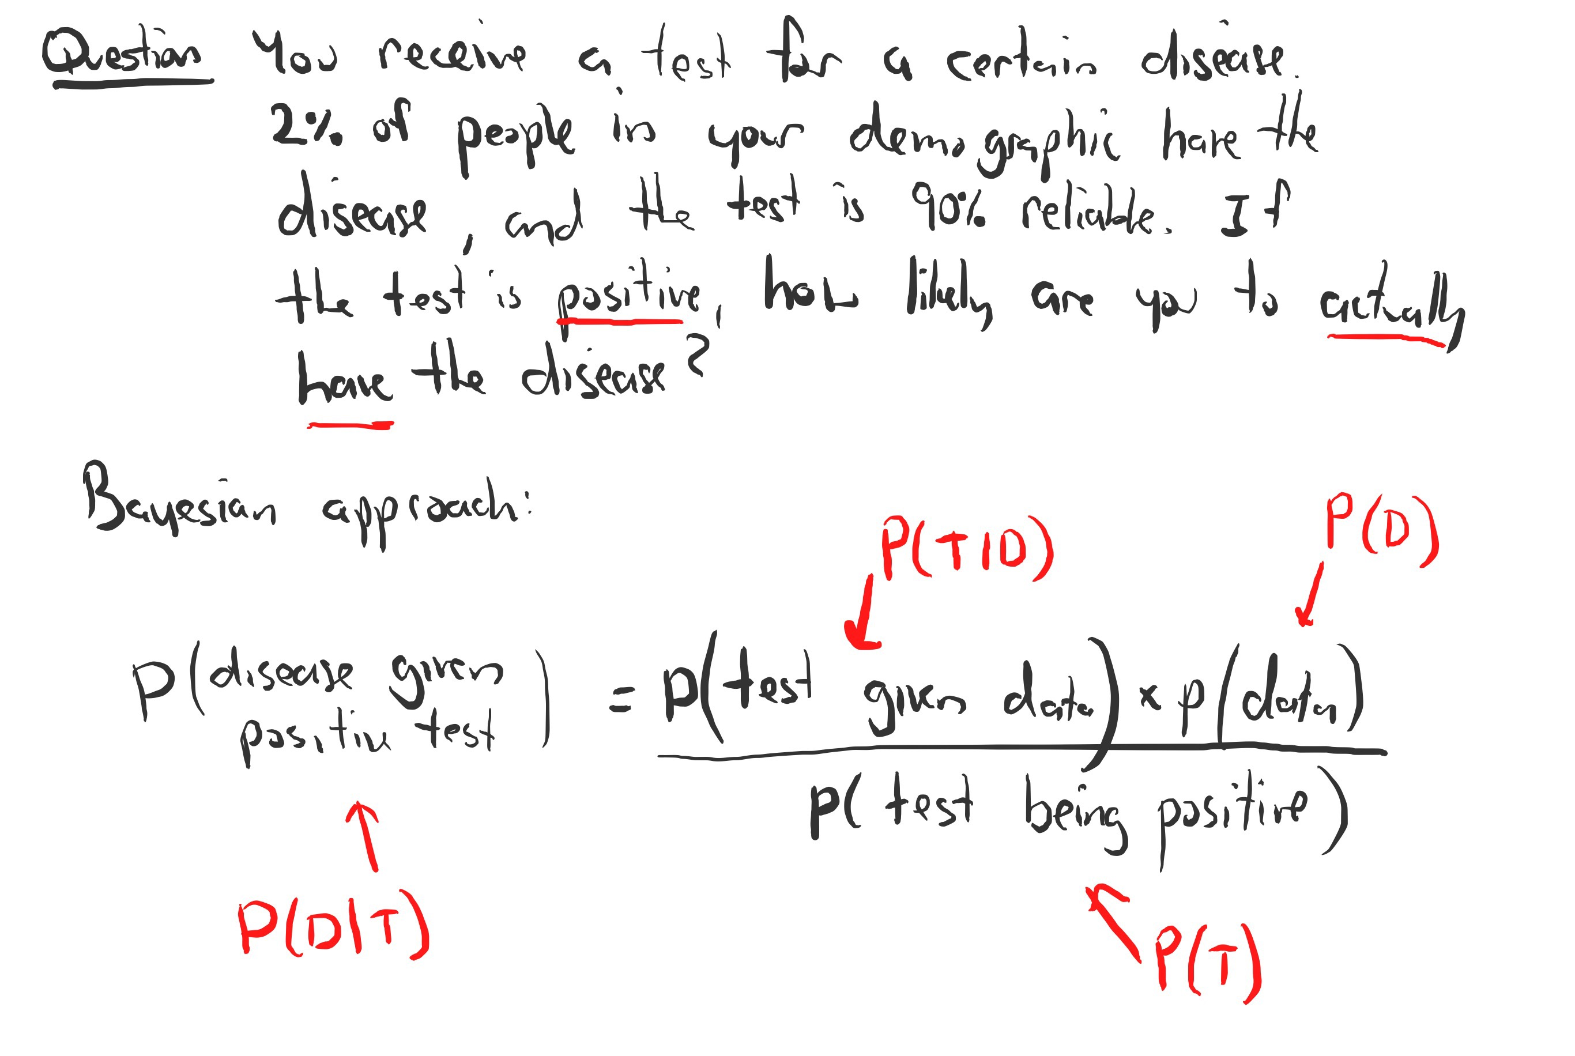

Slide 6
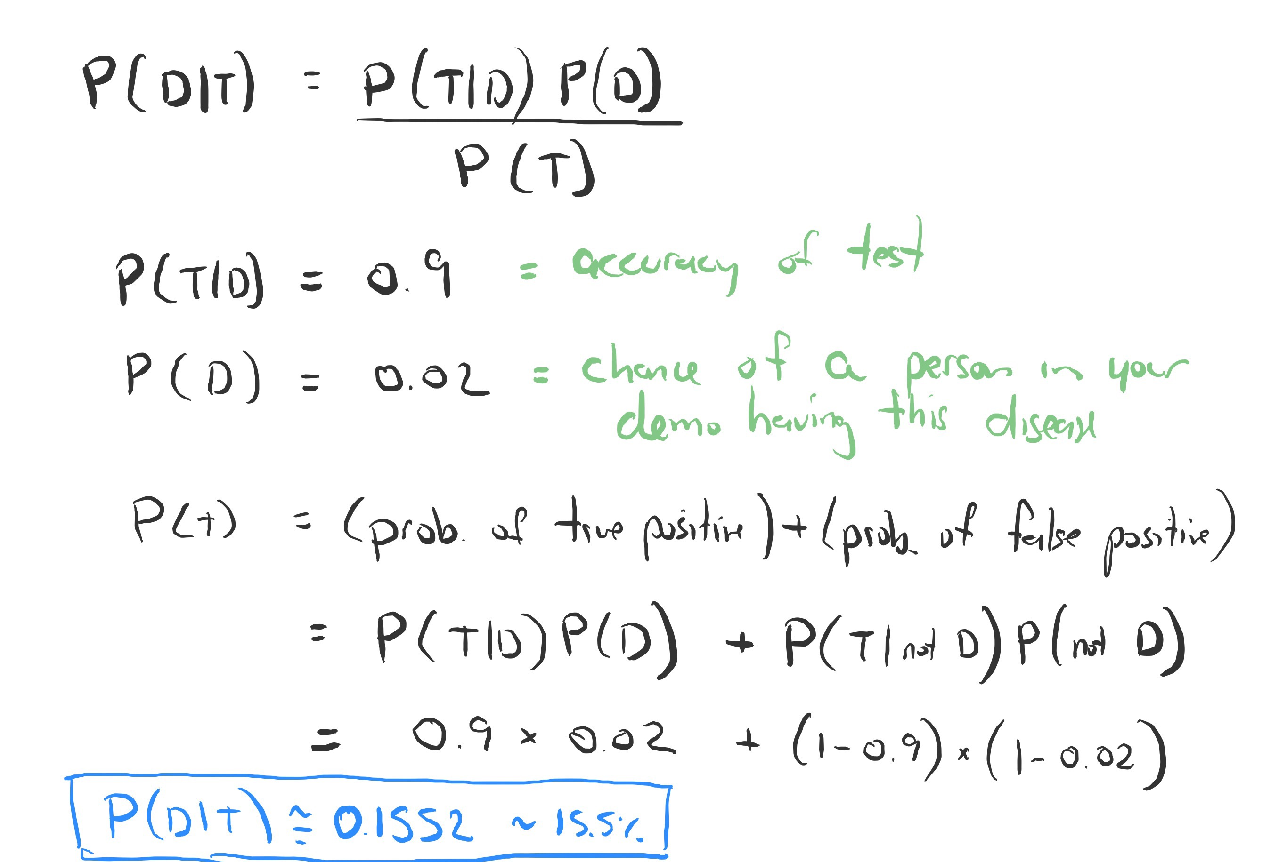

Slide 7
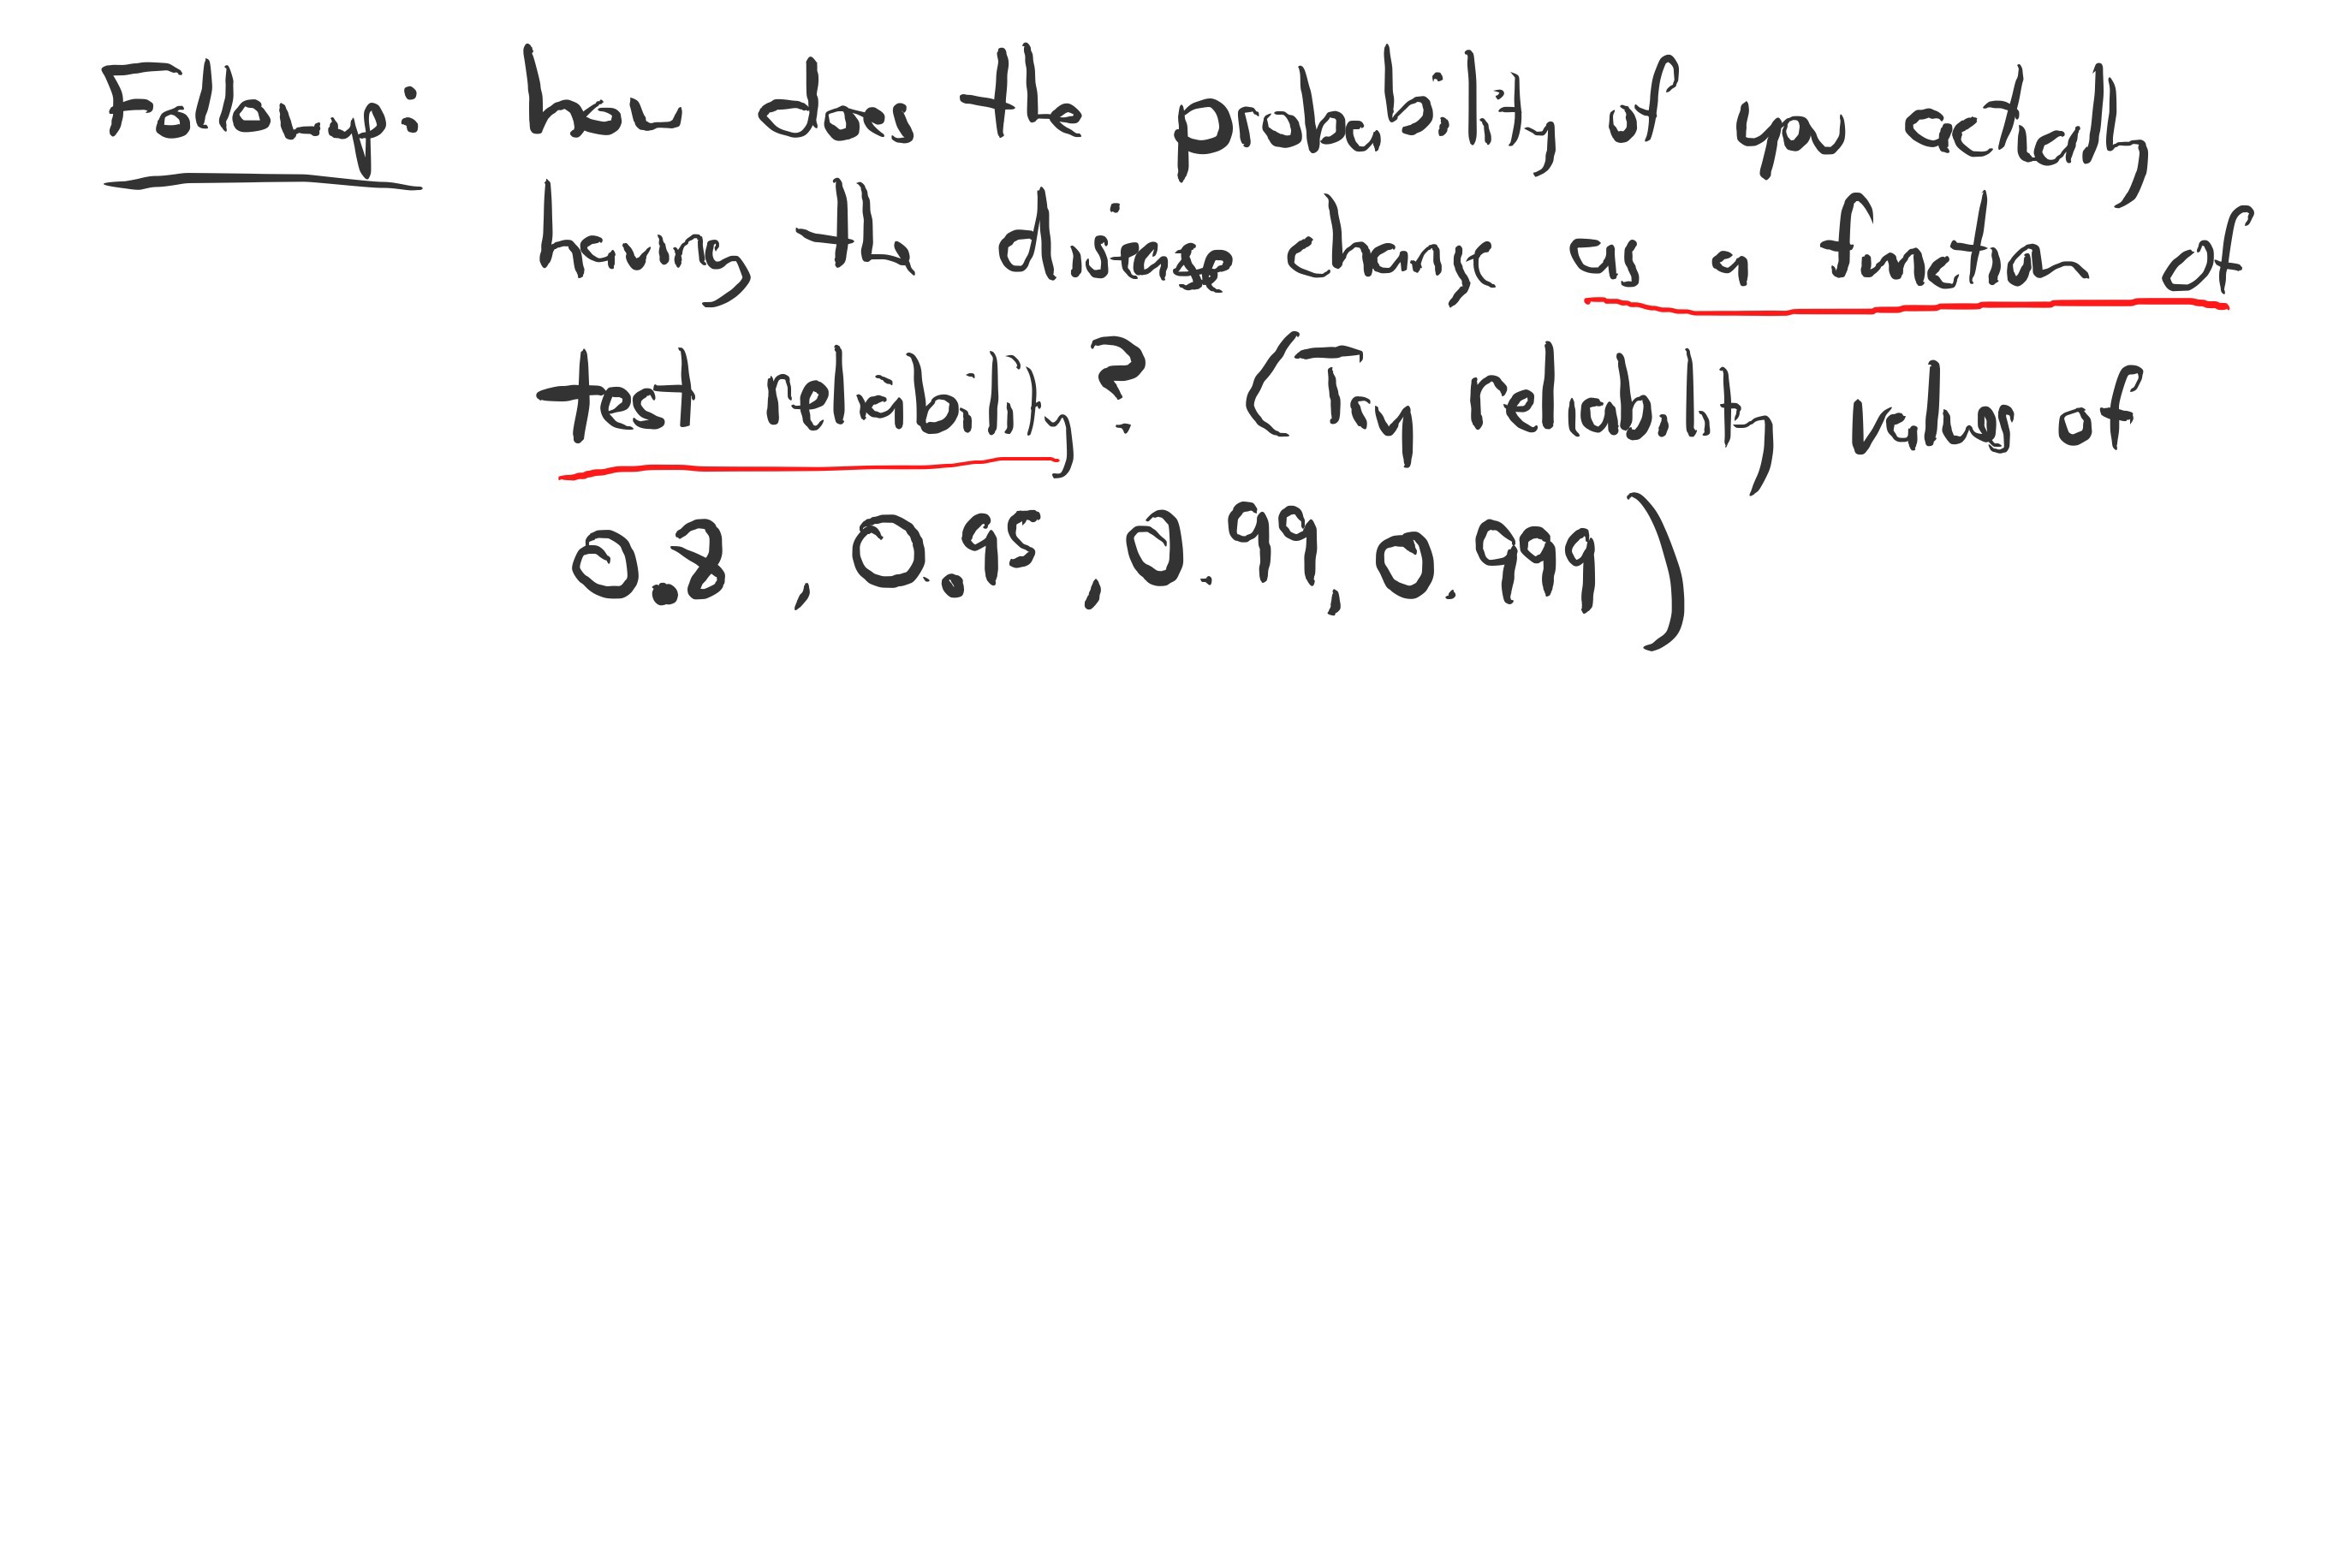

Slide 8
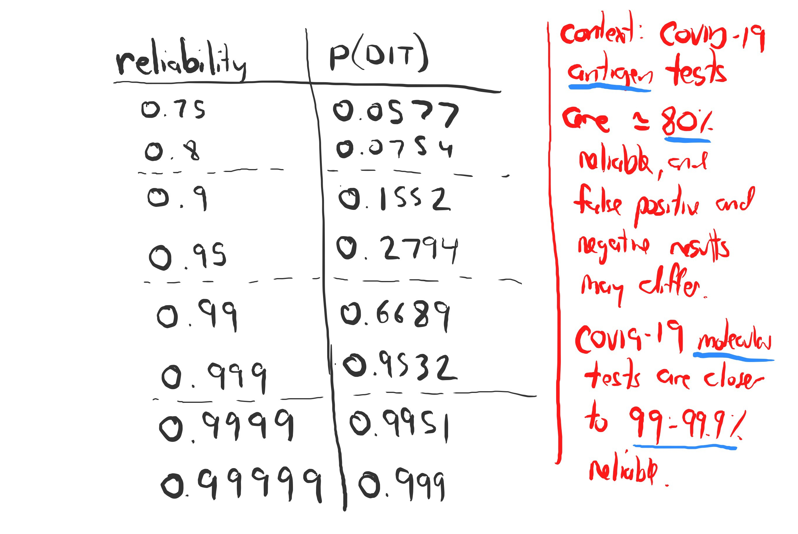
Context: medical tests are essentially never 100% reliable, and some are more reliable than others. Example, flu antigen tests (rapid tests) are only moderately sensitive (50-70% sensitivity, but only 1-5% false positives). Flu molecular tests are much more sensitive (>90%, with <5% false positives).

Slide 9
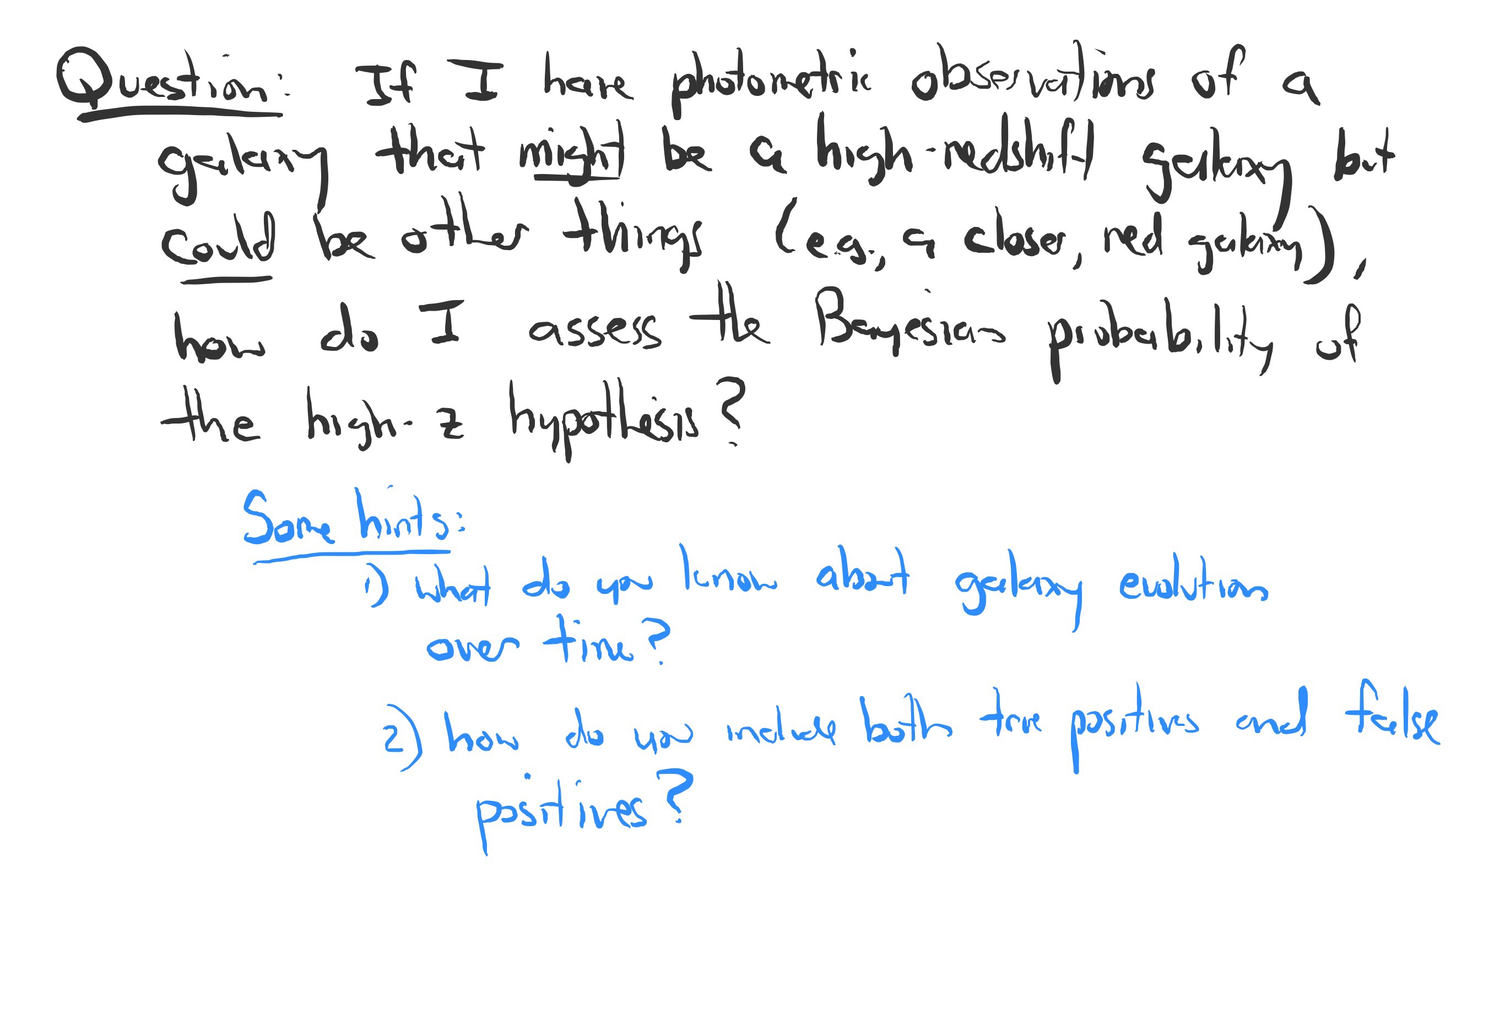

Slide 10
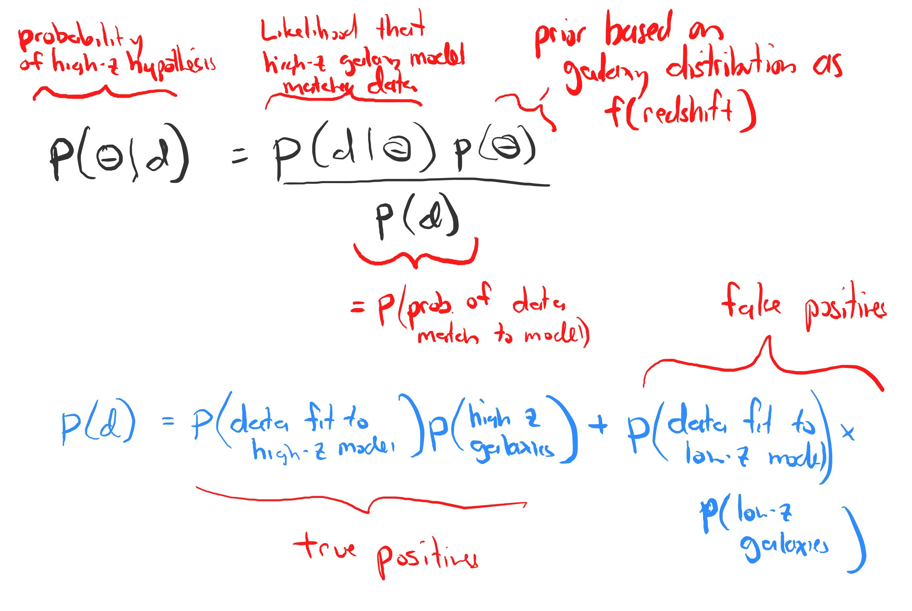

Slide 11
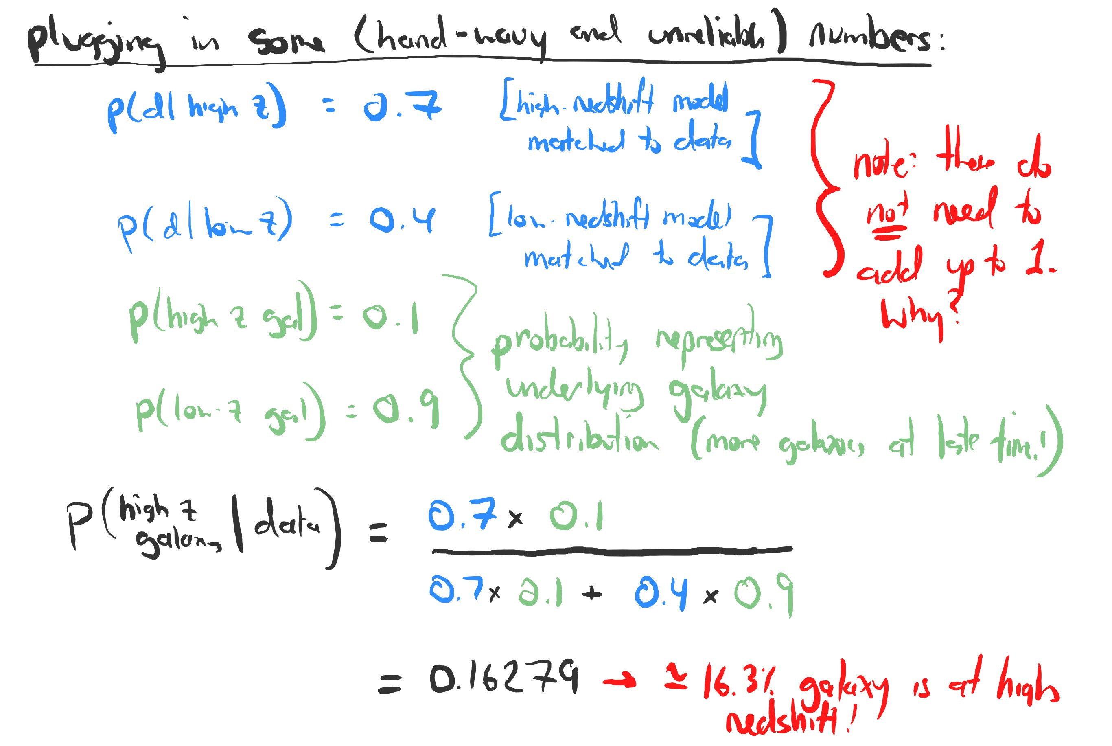

Slide 12
